Slide 1
PREDICTING
CUSTOMER
CHURN
Thanks to Mentor.
Mr. A J Sanchez
By,
Sheema Murugesh Babu

Slide 2
introduction
Churn quantifies the number of customers who have unsubscribed or canceled their service contract. Customers turning their back to a service or product are no fun for any business. It is very expensive to win them back once lost.
Keeping the right customers can be quite valuable for a company. Not only because customer acquisition is much more expensive, but as more and more business models are shifting towards subscription plans, a customer can be worth thousands of dollars in future.
Reducing churn ultimately leads to a sustainable growing business.

Slide 3
Problem statement
The challenge here is to build a model that identifies customers with the intention to leave a service in the near future.
The data contains Demographic information like gender, age range, and whether they have partners and dependents, contains customer account information, services that each customer has signed up for and lastly customers who left within the last month – the column is called Churn.
My solution looks into building machine learning models to predict customer churn. Given the dataset, the model could estimate whether a customer may or may not be unsubscribed to a service.

Slide 4
Dataset information
Dataset was available in Kaggle’s website and was saved into local as ‘BlackFriday.csv’
The data available in the data set has below columns.
Variable | Definition
customerID | Customer ID
gender | Sex of User
SeniorCitizen | Senior Citizen
Partner | Partner
Dependents | Dependents
tenure | Tenure
PhoneService | Phone Service
MultipleLines | Multiple Lines
InternetService | Internet Service
OnlineSecurity | Online Security
OnlineBackup | Online Backup
DeviceProtection | Device Protection
TechSupport | Tech Support
StreamingTV | Streaming TV
StreamingMovies | Streaming Movies
Contract | Contract
PaperlessBilling | Paperless Billing
PaymentMethod | Payment Method
MonthlyCharges | Monthly Charges
TotalCharges | Total Charges
Churn | Churn

Slide 5
Data wrangling steps
Used pandas read_csv module to import the data set.
Upon executing the read_csv function using the info() method, the csv file has 7043 entries and 21 columns with different formats of data. There were no missing values.
Changing the data type of TotalCharges column resulted in error as there were blank spaces in the column. Rectified these errors by replacing them with the mean values of the column.
Changed the data in few other columns like ‘OnlineSecurity’, ‘OnlineBackup’, ‘DeviceProtection’, ‘TechSupport’, ‘StreamingTV’, ‘StreamingMovies’, ‘MultipleLines’ and ‘SeniorCitizen’. Also added an extra column called TenureGroup to group the data from Tenure column.

Slide 6
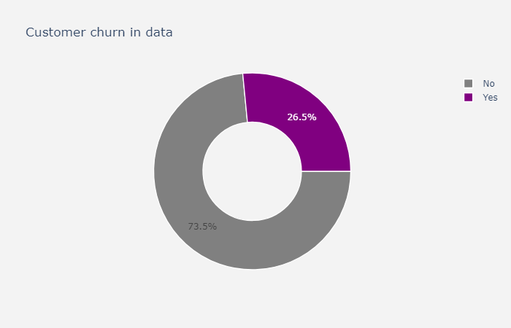
Data Storytelling
After I wrangled and cleaned the dataset, I started to explore the data in detail. To put great visualizations, I used ‘Plotly’ library.
Only 26.6% of the data represents churn customers and the majority are the non-churn customers.
We might be dealing with a class imbalance problem as there are more non-churned customers than the churned ones.

Slide 7
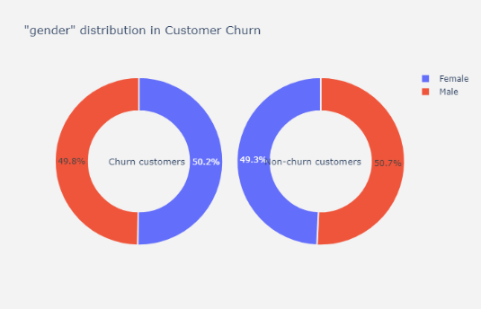
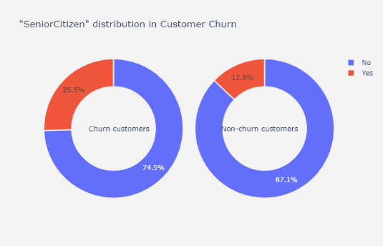
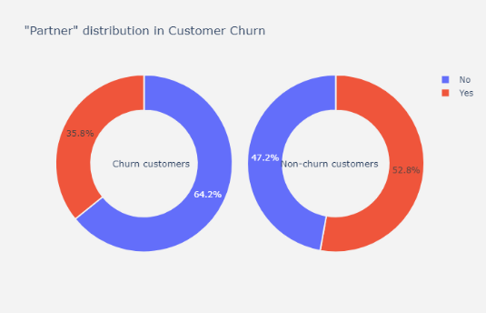
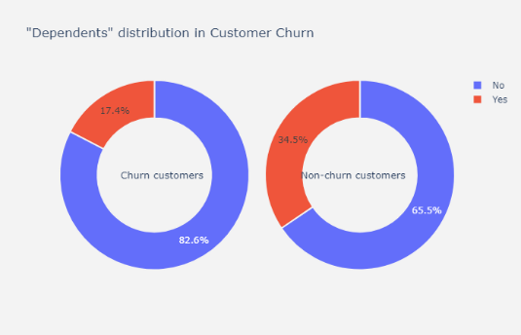
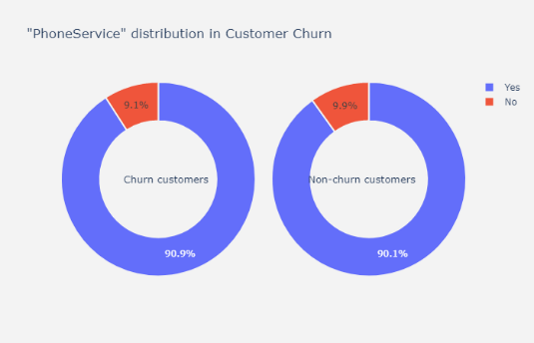
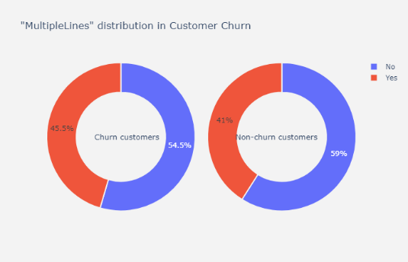
Plots for some of the categorical columns

Slide 8
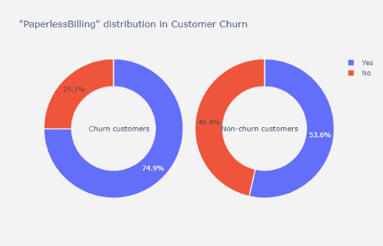
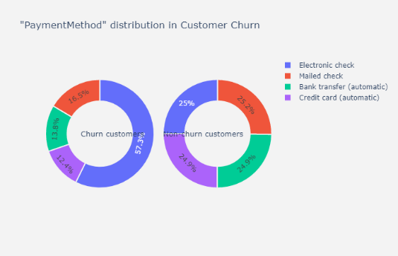
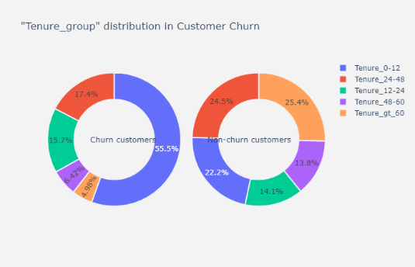

Slide 9
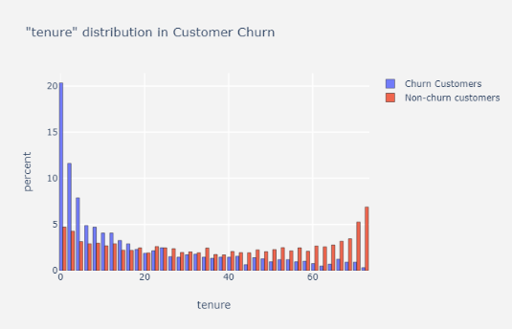
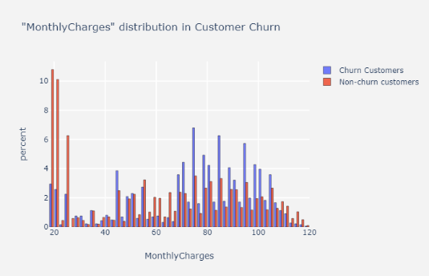
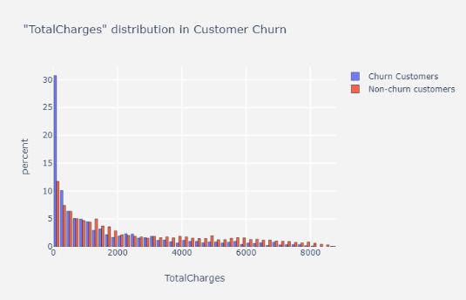
Histograms for all the numerical columns

Slide 10
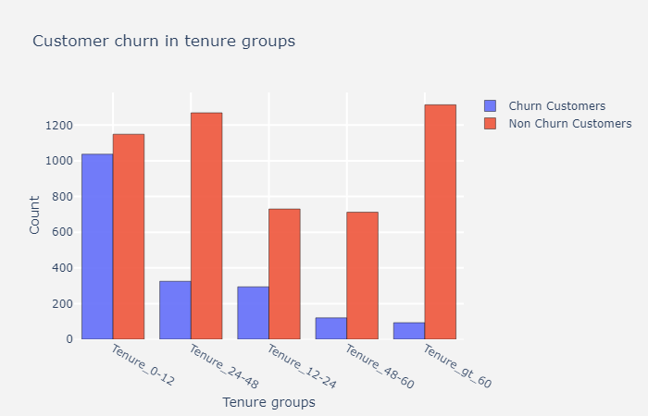
Customer Churn in Tenure groups

Slide 11
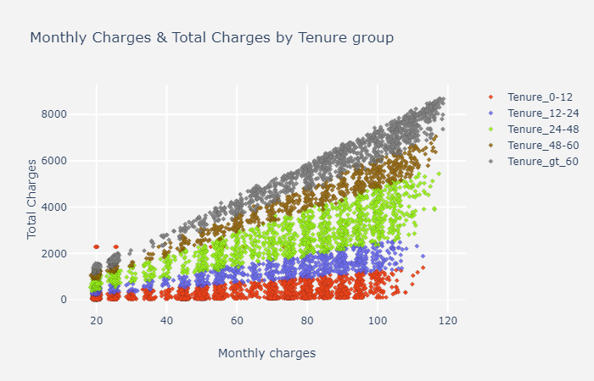
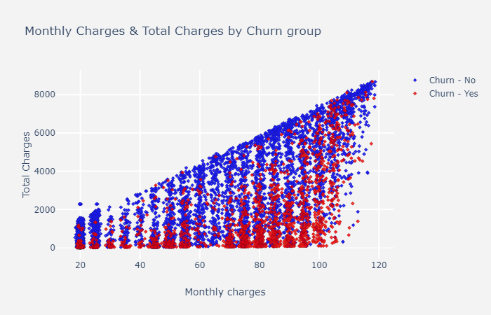
Monthly Charges and Total Charges by
Tenure group and Churn group

Slide 12
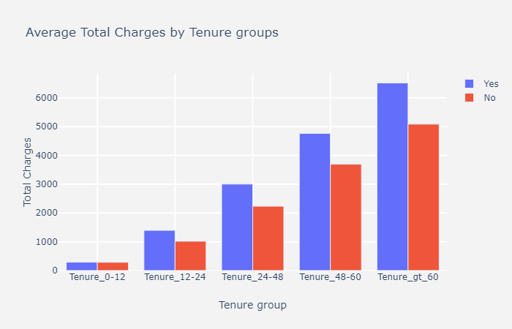
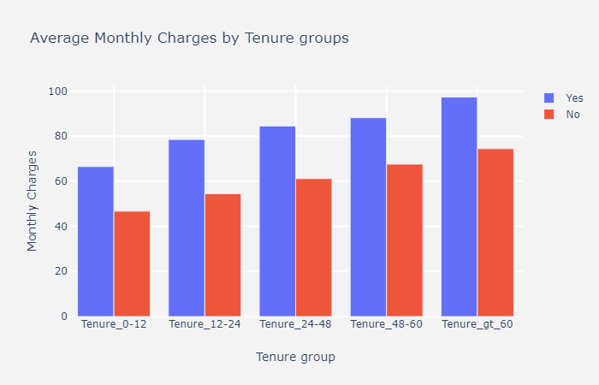
Average charges by Tenure Groups

Slide 13
Hypothesis Testing - Chi-Square Test
The Pearson’s Chi-Squared test, or just Chi-Squared test is a statistical hypothesis test that assumes (the null hypothesis) that the observed frequencies for a categorical variable match the expected frequencies for the categorical variable. The test calculates a statistic that has a chi-squared distribution, named for the Greek capital letter Chi (X) pronounced “ki” as in kite.
The Chi-Squared test uses something called a contingency table, by first calculating the expected frequencies for the groups, then determining whether the division of the groups, called the observed frequencies, matches the expected frequencies. The result of the test is a test statistic that has a chi-squared distribution and can be interpreted to reject or fail to reject the assumption or null hypothesis that the observed and expected frequencies are the same.

Slide 14
Inferential Statistics
Imported the ‘chi2’ and the ‘chi2_contingency’ from the scipy.stats library and wrote a function for Contingency table for all the categorical columns and the numerical columns.
The function returned a Contingency table for each categorical/numerical column against the target variable i.e. Churn, degrees of freedom, expected values, the test statistics such as Probability, Critical values, Chi-square statistic, significance and the p-value.
If the p-value < 0.05, it would mean there is a relationship between the 2 categorical variables.

Slide 15
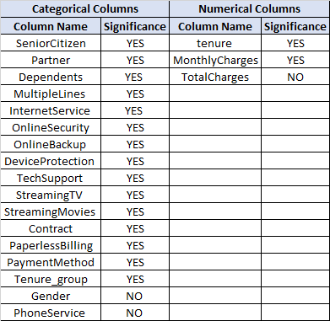
Table shows the significance of all the Categorical and Numerical Columns.

Slide 16
Baseline modelling
Used Label encoding for all the binary columns and created dummy variables for them using the get_dummies method of pandas to create dummy features for all the categorical data.
Used Train Test Split method to split my data set into “X”, “y”.
The variable ‘X’ contains all columns except the target variable and the variable ‘y’ contains only the target variable.
The training set is 75% of our total data and training set is 25% of the data.

Slide 17
Baseline modelling – logistic Regression
Instantiated a Logistic Regression object, fitted on the Training set, predicted on the test set and calculated different scoring metrics to measure the performance of the model.
Classification Report Summary for Logistic Regression (LR):
The class of interest (Churn class) for the training set has only 67% precision and 53% recall score and the test set has 68% precision and 51% recall score.
Our model for the churn classes has not performed great. But the overall global accuracy scores were much higher than the individual scores for the churn class.

Slide 18
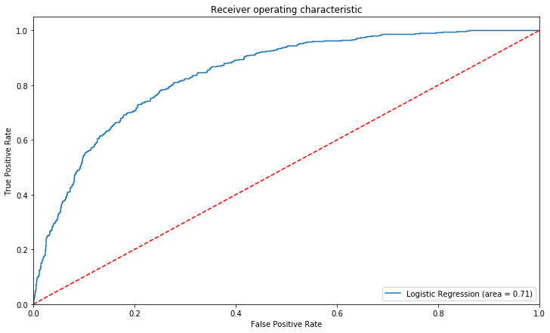
ROC curve for Logistic Regression
The Area Under Curve for the Logistic Regression model is 0.706359628925045.

Slide 19
Extended modelling
Performed below listed modelling
Logistic Regression with Undersampling.
The class of interest for the train set now has 69% precision and 64% recall score and that of the test set has 64% precision and 63% recall score.
Logistic Regression with GridSearchCV.
There wasn’t much of a difference in the recall scores for the two. Hence, we could say there is no overfitting.
XGBoost with SMOTE.
The class of interest for the train set for XGBoost model has 88% precision and 87% recall score and that of the test set has 64% precision and 58% recall score.
XGBoost with GridSearchCV.
The class of interest for the train set for XGBoost with GridSearchCV has 92% precision and 88% recall score and that of the test set has 65% precision and 55% recall score.

Slide 20
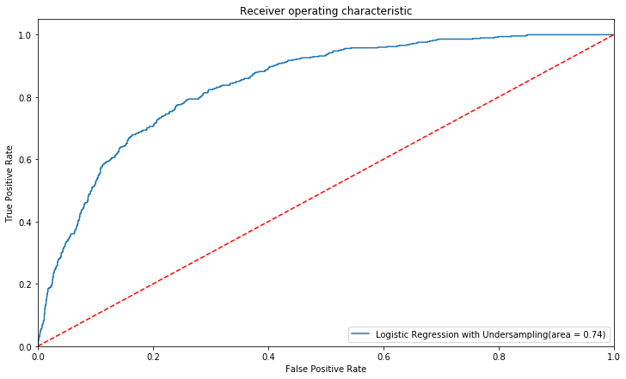
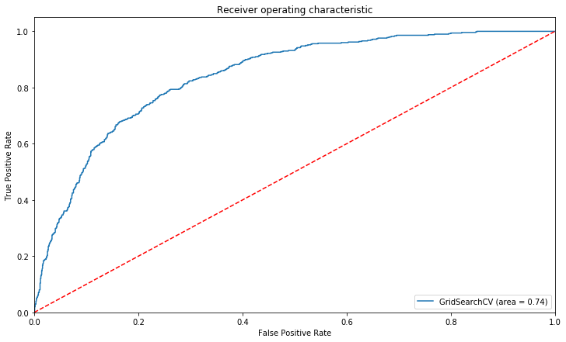
ROC curve for Logistic Regression with Undersampling
ROC curve for Logistic Regression with GridSearchCV
Area Under Curve for the Logistic Regression with undersampling is 0.7424984676166914.
Area Under Curve for the GridSearchCV model is 0.7414964636086754.

Slide 21
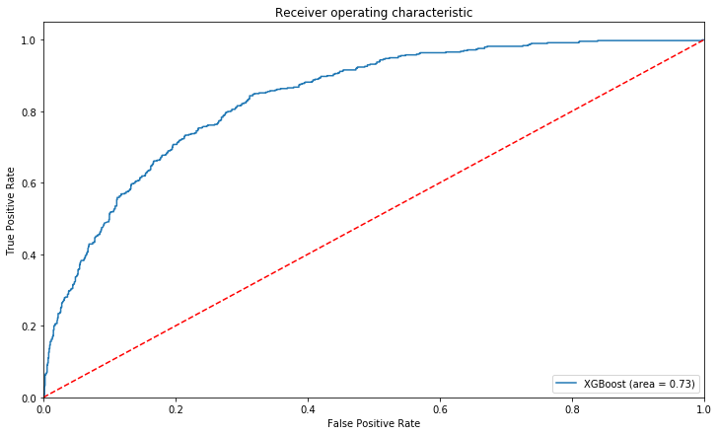
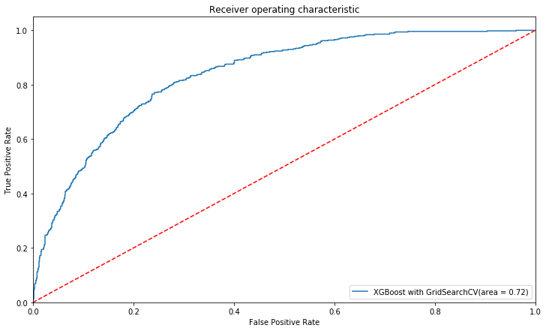
ROC curve for XGBoost with
SMOTE
ROC curve for XGBoost with GridSearchCV
Area Under Curve for the XGBoost model is 0.7252087376019867.
Area Under Curve for the XGBoost model with GridSearch is 0.7161216251838066.

Slide 22
Findings
Algorithms | Precision | Recall
Logistic Regression (LR) | 68% | 51%
LR with Undersampling | 64% | 63%
LR with GridSearchCV | 64% | 62%
XGBoost with SMOTE | 64% | 58%
XGBoost with GridSearchCV | 65% | 55%

Slide 23
Conclusions and Future Work
Previously, we jotted down the metrics for all the machine learning models.
We can conclude that Logistic Regression with undersampling performed better for the recall score which is our metric of interest.
Going forward I would like to improve the performance of the XGBoost model by using more parameters and also by trying out different algorithms.

Slide 24
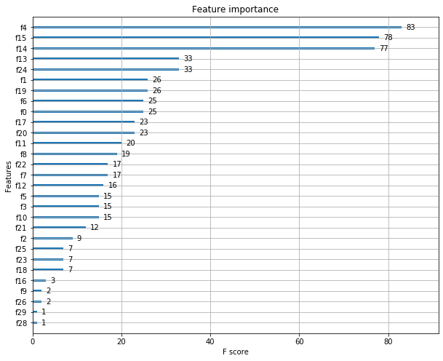
Recommendation for the Client
Feature Important Plot for XGBoost Model
The top 5 features are f4, f15, f14, f13, f24 and so on. Future work involves finding out the exact feature names for these numbers.

